Slide 1




Business Skills for Developers
Software Company Structure, Product Management, Marketing, Sales, Business Strategy and More
Margarita Antonova
IT
Business System Analyst
Telerik Corporation
Developers
Volunteer Trainer @ Telerik Academy
Business
Product
academy.telerik.com

Slide 2


Table of Contents
The Trainers Team
Course Format
Course Syllabus
Exams and Evaluation
Standard Criteria & Bonuses
Course Project
Resources for the Course
Introducing the Themes

Slide 3
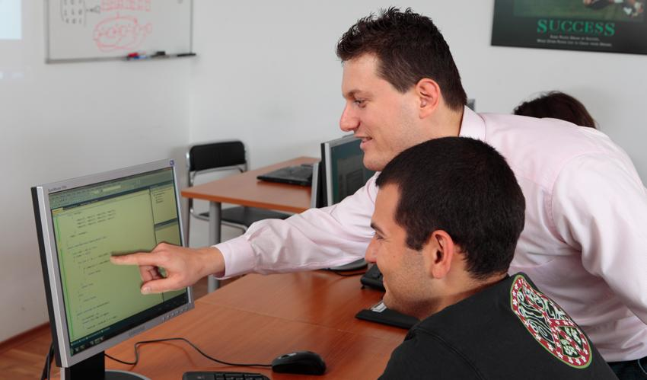
The Trainers Team

Slide 4
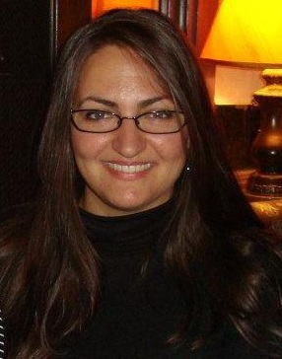


Trainers Team
Margarita Antonova – Maggie
MBA and BS in Commerce
Experience in Sales and
Marketing of Software
Business System Analyst
margarita antonova
maggie antonova

Slide 5
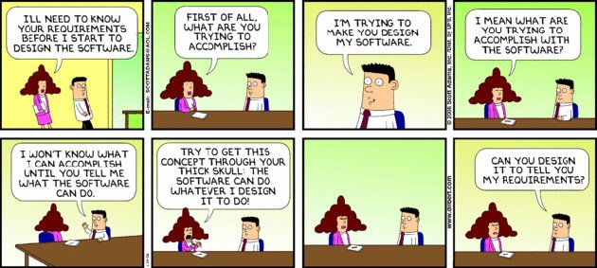
My Job

Slide 6

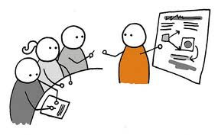

Course Format
How Is the Course Going to Be Conducted?

Slide 7


Course Syllabus
What Are We Going to Cover?

Slide 8
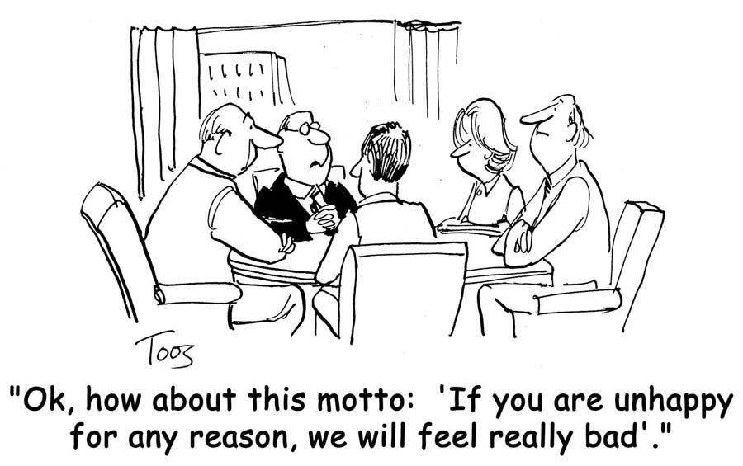
Syllabus
Who do we sell to and why is it challenging?
March 27th

Slide 9
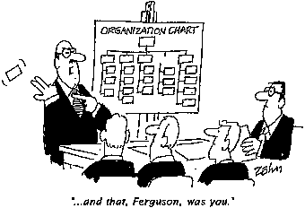
Syllabus
Software Company Typical Structure
April 3rd

Slide 10
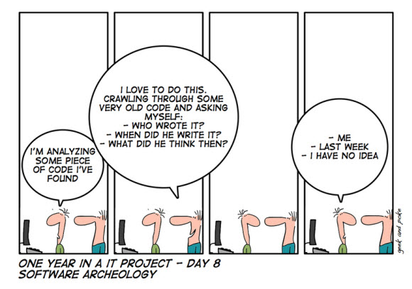
Syllabus
Role of the Software Engineers – Production & Support
April 10th

Slide 11

Syllabus
How Does the Business Work?
April 17th

Slide 12
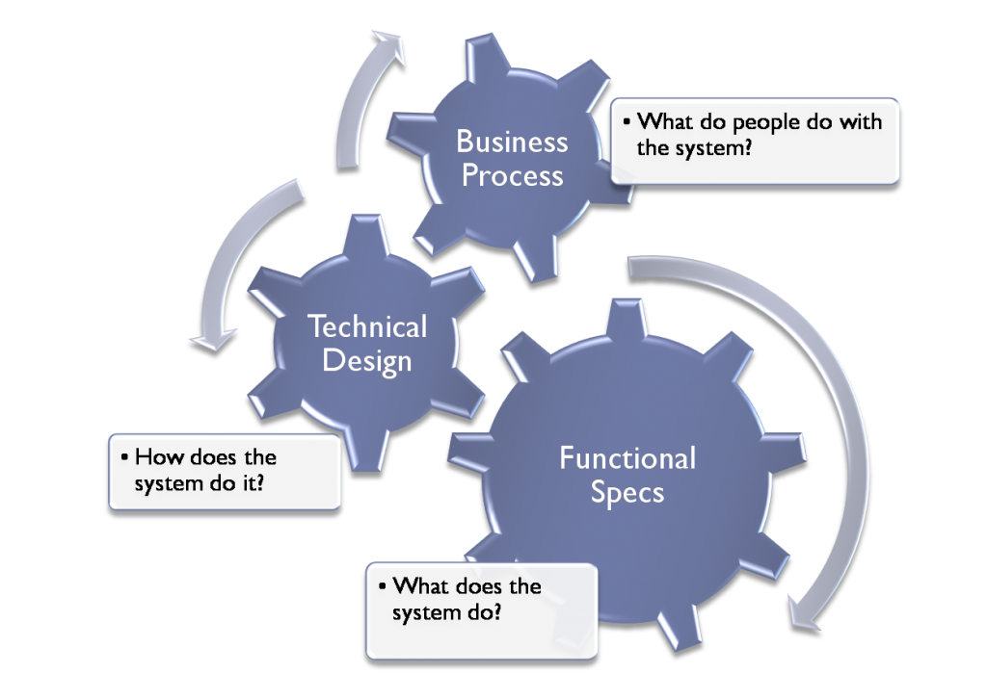
Syllabus
Product Development
April 24th

Slide 13
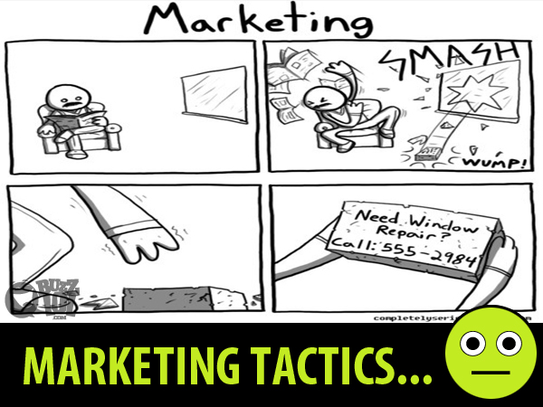
Syllabus
Marketing & Advertising
May 1st

Slide 14
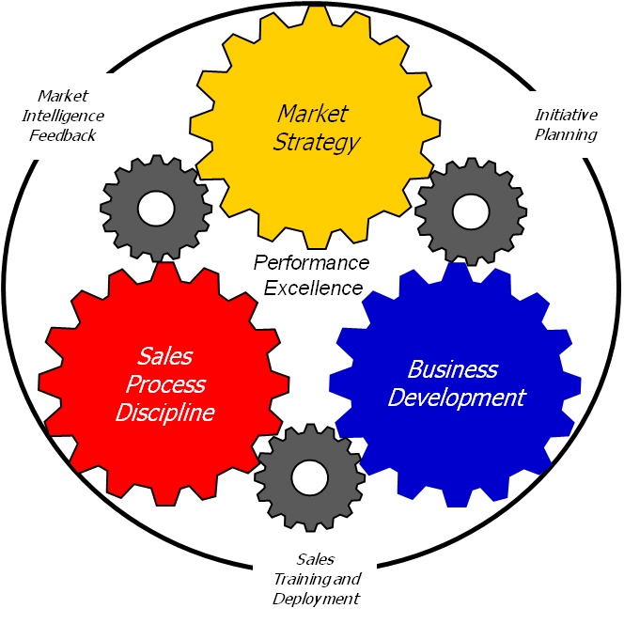
Syllabus
Sales Process & Sales Cycle
May 8th

Slide 15
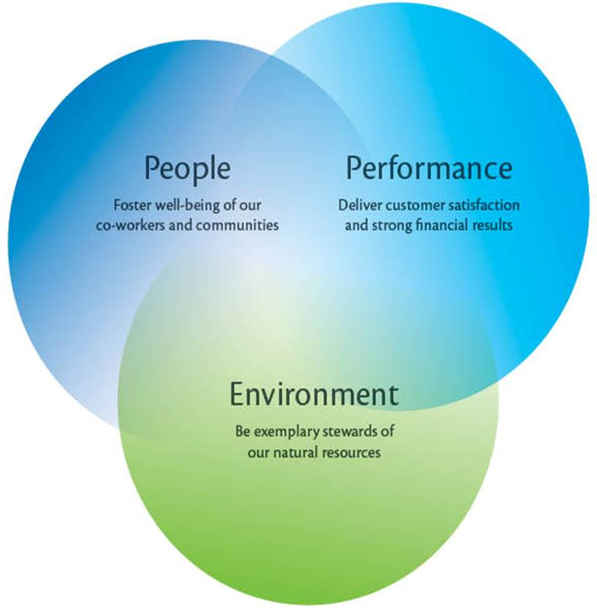
Syllabus
How to Sustain Our Business?
May 15th

Slide 16
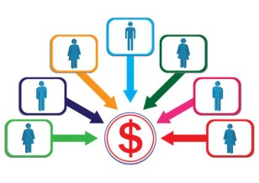
Course Goal
To familiarize software engineers with the basic business structures and processes that affect the development of software and hence their own work experience.

Slide 17



Evaluation
Exams, Criteria, Bonuses

Slide 18
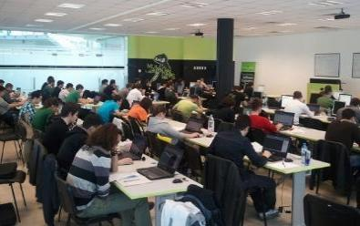

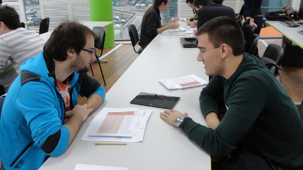
Business Skills – Evaluation
Evaluation components
Practical Project – 60%
Homework – 15%
Homework evaluation – 15%
3 peer reviews per homework
Attendance in class – 10%
Bonuses
Forums – bonus up to 20%

Slide 19

Practical Group Project
Business Plan for Your Own Product
Executive summary
Marketing Plan
Operations Plan
Financial Plan
Risk analysis
Decision Making Criteria
Due Date: June

Slide 20

Homework Assignments
Warm Up: Answer the Business Questions
Idea Generation: Design Your Company & Gather Product Ideas
Cost-Benefit Analysis of Your Product Ideas
Operations Plan
SWOT Analysis
Marketing Mix Analysis - 7Ps
Sales Force Operations Plan
Porter’s 5 forces

Slide 21
Homework Peer Reviews
Everyone will get feedback for their homework
Everyone will give feedback for few random homework submissions
Students submit homework anonymously
Please exclude your name from the submissions!
For each homework submitted
Students evaluate 3 random homeworks
From the same topic, after the deadline
Give written feedback, at least 200 characters
Low-quality feedback → report for punishment

Slide 22
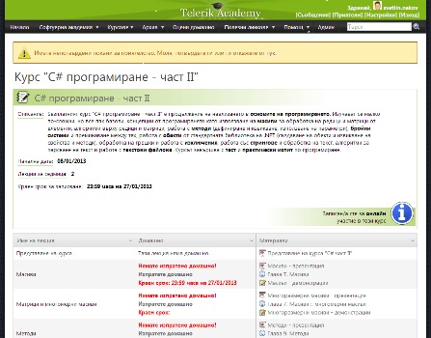
Telerik Integrated Learning System (TILS)
The Telerik Integrated Learning System (TILS)
www.telerikacademy.com
Important resource for all students
Homework submissions
Homework peer reviews
Presence cards with barcode
Reports about your results
http://telerikacademy.com/Courses/Courses/Details/39

Slide 23
Course Web Site & Forums
The Business Skills course official web site
Register for the "Telerik Academy Forums":
Discuss the course exercises with your colleagues
Find solutions for the exercises
Share and discuss ideas and analysis
http://academy.telerik.com/student-courses/soft-skills-and-business-skills/business-skills-for-developers/about
Business Skills at the Academy Forums

Slide 24








Resources
What We Need in Addition to This Course Content?

Slide 25
Recommended Resources
Fast Company - www.fastcompany.com
Wired Magazine - www.wired.com
TechChrunch - http://techcrunch.com/
Wall Street Journal / Personal Technology - http://online.wsj.com
New York Times / Technology - http://www.nytimes.com/pages/technology/index.html
Business Week / Technology - www.businessweek.com/technology
CIO, international - www.cio.com
LinkDIn - topical groups
StatCounter Global Stats - http://gs.statcounter.com/
McKinsey Quarterly - http://www.mckinseyquarterly.com
Advertising Age - http://adage.com/

Slide 26




The Important Questions
If we are software engineers, why do we need business skills?

Slide 27

The Important Questions
Is software a house?

Slide 28
The Important Questions
The Software Challenge:
What is software?
How do you define software?
Is it a product, a service, an experience?
How do you know you need it?
How do you evaluate it?
How do you purchase it?
Build vs. Buy

Slide 29

The Important Questions
A Business Approach Can Help
What do we sell?
How are we making it?
Where do we sell?
How do we sell?
Are we making a profit?
How do we continue to sell at a profit?
Who do we sell to?

Slide 30
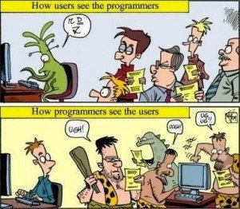
The Important Questions
Who do we sell to?
Who do we code for?

Slide 31
Who Do We Code for?
The End User
Looking to complete a task with our software product/service usually in the fastest easiest way.
In most cases is interested in an end result not the process or the details
In most cases will not have the expertise, knowledge and insight on the product we do.
It is good to have a middle-man – the business analyst, product manager and project manager – but YOU are important too

Slide 32
Who Do We Code for?
The End User
Is a CLIENT – the client is always right and usually paying or significantly contributing to our revenue
B2B vs. B2C

Slide 33



Summary & Examples
Defining software is hard
Selling software is hard
Software is for the user
Software development is a business

Slide 34
Business Skills for Developers: Course Intro
http://academy.telerik.com/student-courses/soft-skills-and-business-skills/business-skills-for-developers/about

Slide 35




Class Group Discussion
Product vs. Service
Experience economy aspect
Who are the end users
What is their need
What challenges they face in using/buying the software

Slide 36






Homework Assignment
Answer the business questions for a phone operating system of your liking.
Deadline – in 2 weeks
Format
Operating system: ?
Manufacturer: ?
A few sentences answering:
What do they sell?
How do they make it?
Who do they sell to?
Where do they sell?
How do they sell?
Are they profitable?
Are they sustainable?

Slide 37



Free Trainings @ Telerik Academy
Business Skills for Developers @ Telerik Academy
http://academy.telerik.com/student-courses/soft-skills-and-business-skills/business-skills-for-developers/about
Telerik Software Academy
academy.telerik.com
Telerik Academy @ Facebook
facebook.com/TelerikAcademy
Telerik Software Academy Forums
forums.academy.telerik.com

